Slide 1
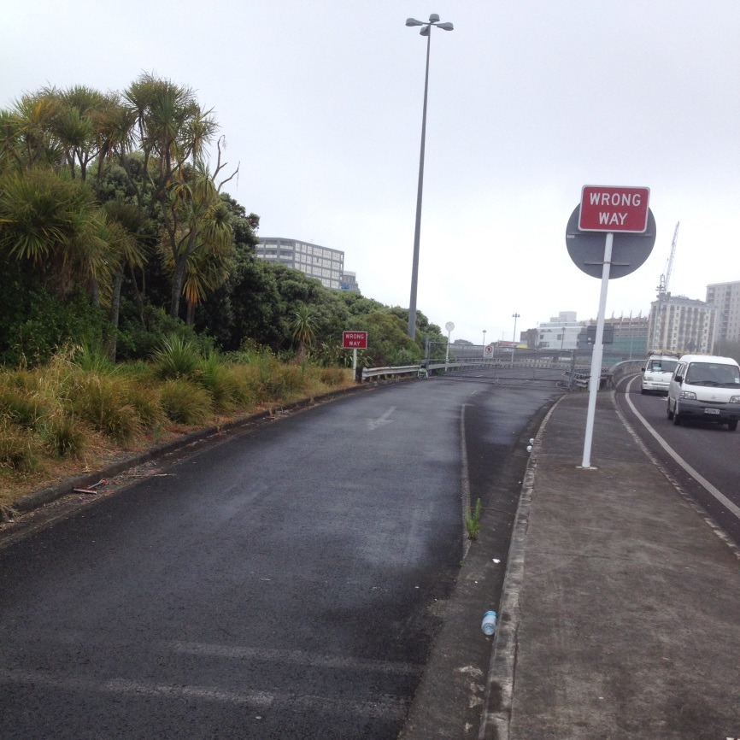
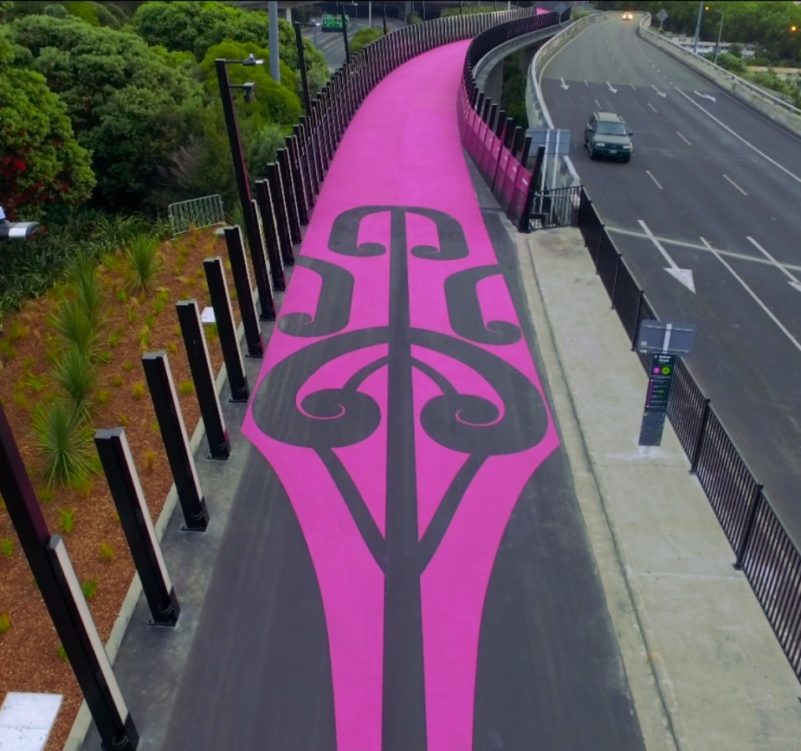
From Disused Offramp to New Urban Space
Stephen Cummins | Project Manager
Image placeholder
Image placeholder

Slide 2
What Were the
What is the purpose of my talk?
What were the challenges we faced, how we adapted, and how the project evolved

Slide 3
What Were the
What I would like you to remember?
Critical to the Success:
Teamwork
Opportunity & Evolution

Slide 4
What Were the
Presentation Structure
Background
Challenges
Options reassessment
Tender/Planning
Construction

Slide 5
Background
Setting the scene

Slide 6
The Team

Slide 7
Location

Slide 8
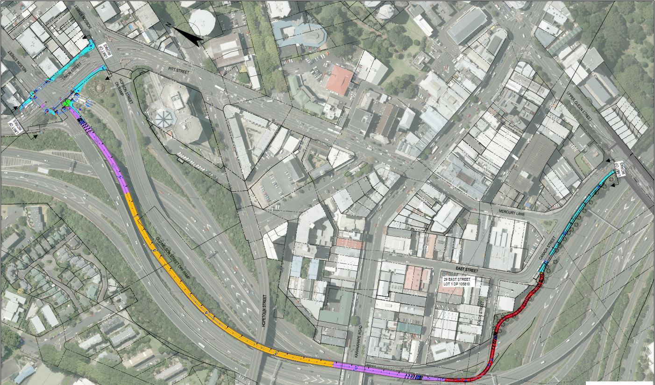
Project Drivers
Link A to B
Programme Programme programme
B
A

Slide 9
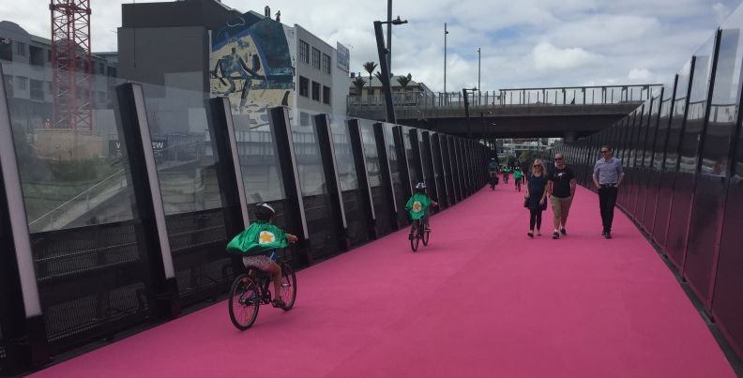
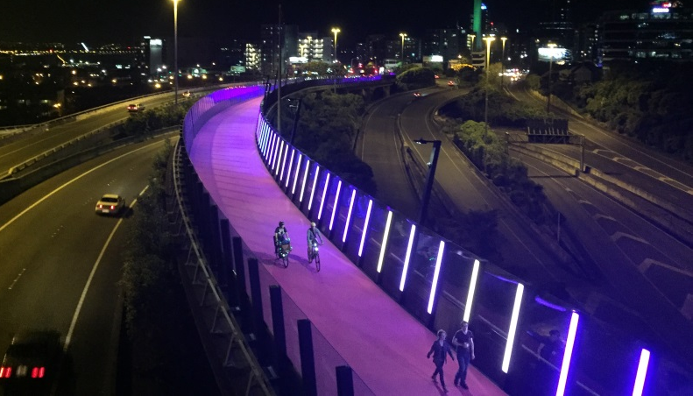
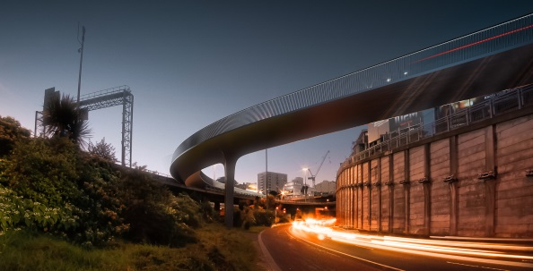
Notable Exclusions
Image placeholder
Magenta Surfacing
295 Interactive LED Feature Lighting
Surpassed expectation - shortlisted for the Infrastructure Future Project Award at 2015 World Architectural Awards.
Image placeholder
Image placeholder

Slide 10
Think modest…

Slide 11
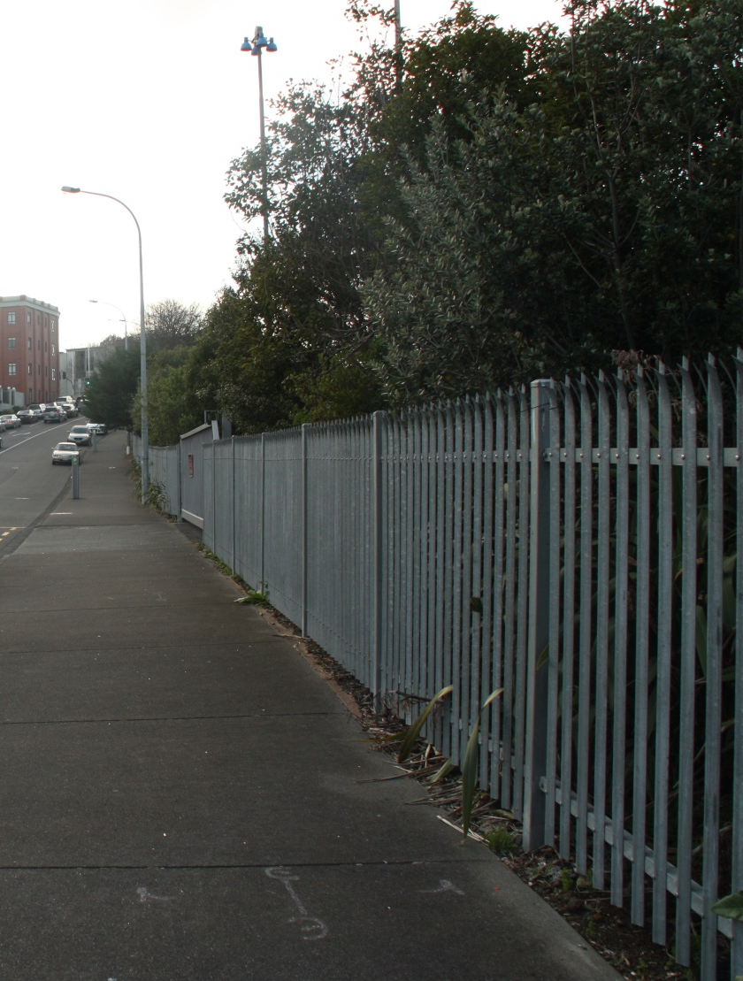
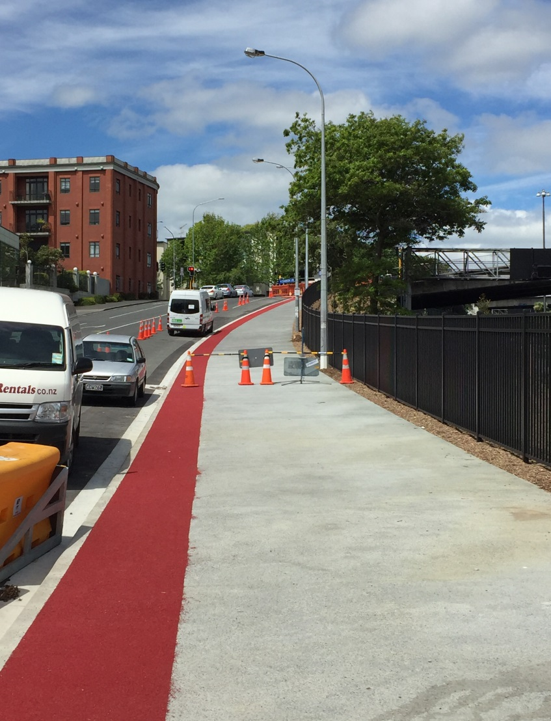
….a lot more modest
Image placeholder
Image placeholder

Slide 12
Design Team Brief
“timeframes are tight…let’s do our best. The end outcome will be quite an extraordinary piece of infrastructure that we will all be proud off.”
Gansen Govender, GHD Design Manager
Canada St Bridge
“Cyclists and pedestrians will enjoy using…
The citizens of Auckland will be proud of”
New Zealand Transport Agency

Slide 13
Challenges
How they shaped the project

Slide 14
Key Challenges
Options
Tender /
Planning
Construction
Story of the Options reassessment
Story of the Canada St Bridge
Story of the Offramp

Slide 15
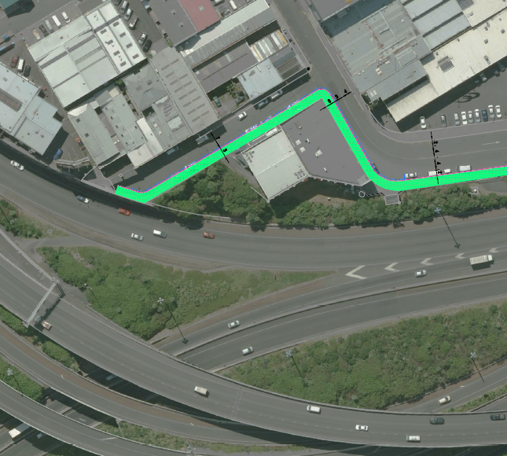
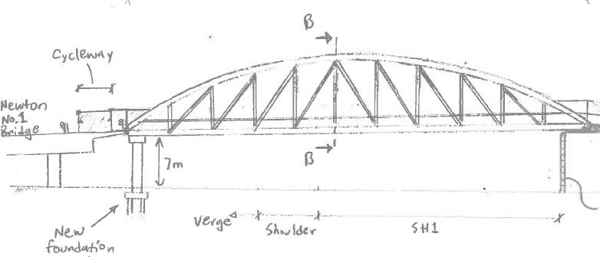
Original Option
Key Points:
South St
Truss Bridge
Issue:
Alignment - Safety
Gradients
CPTED – Safety
Programme
Image placeholder

Slide 16
New Option
Key Points:
Canada St
Disused land
Key Benefits:
Alignment & Gradient
CPTED
Programme
Issues:
Engineer Complexity

Slide 17
Key Challenges
Options
Tender /
Planning
Construction
Story of the Option reassessment
Story of the Canada St Bridge
Story of the Offramp

Slide 18
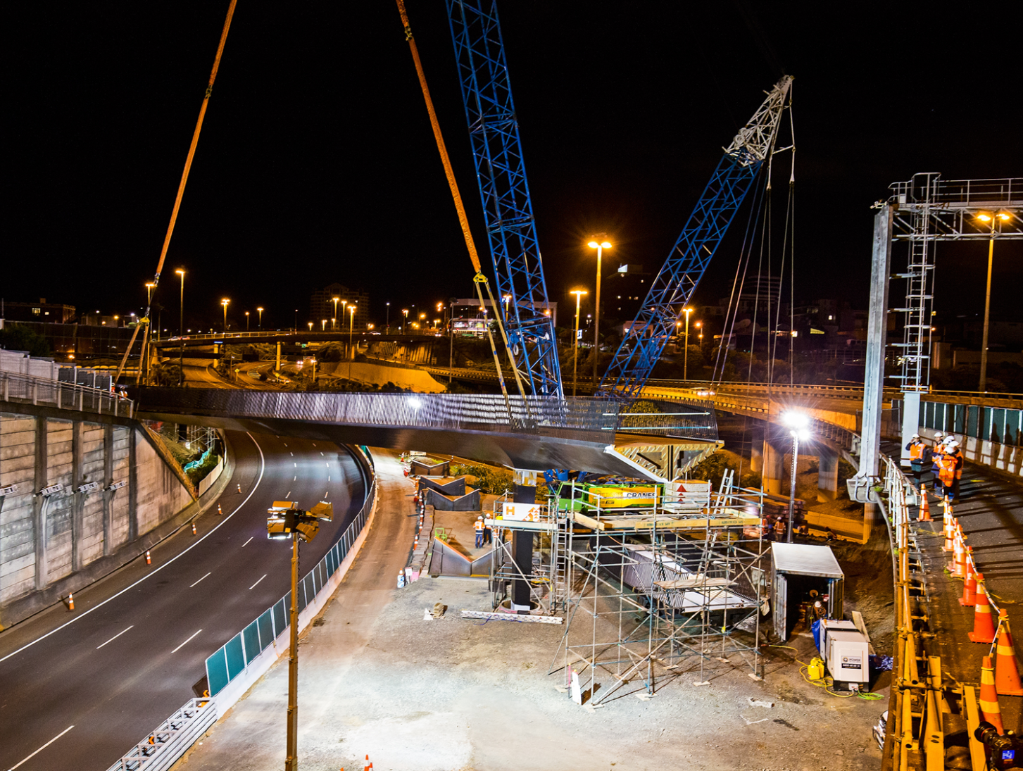
Why Steel?
Span
Longest span was 54m over SH1 (96 ton)
Minimise traffic disruption
Lightweight, prefabricated offsite and lifted into place overnight
Image placeholder

Slide 19
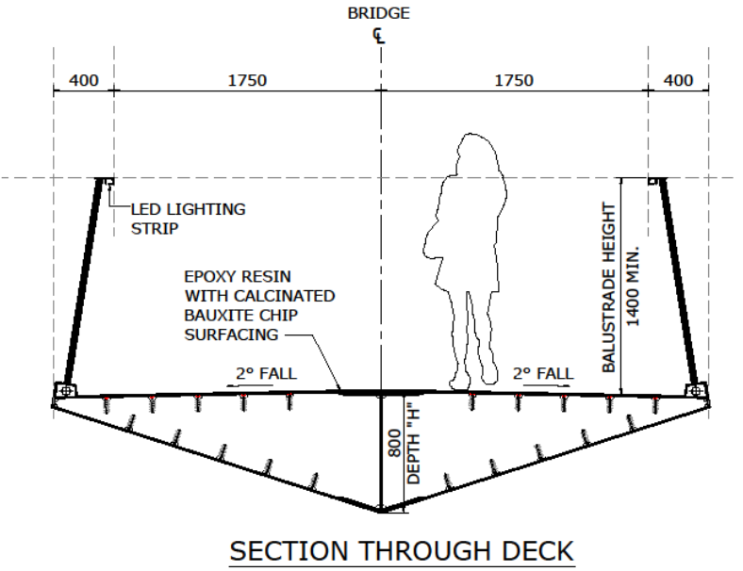
Why a triangular shape?
This gives the steel torsional strength required due the alignment – curves
Architect used this form to design an elegant structure
Image placeholder

Slide 20
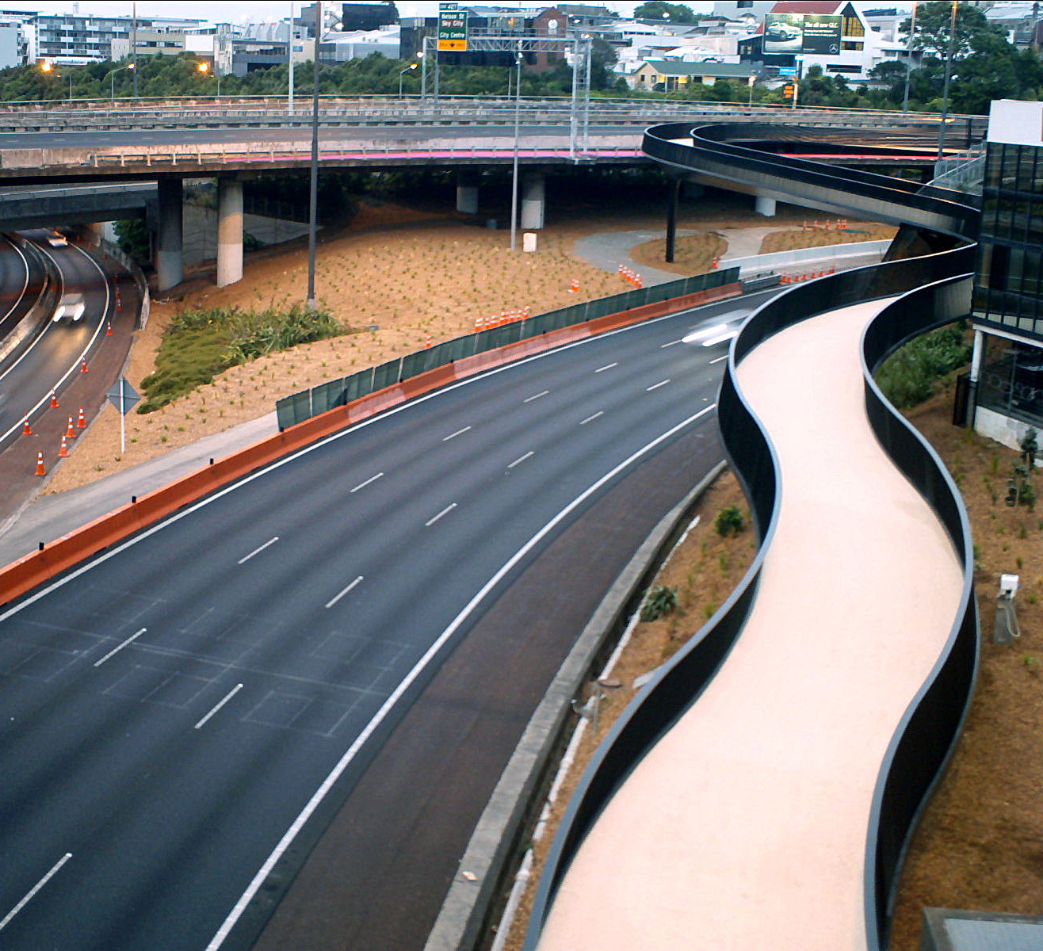
Why all the curves?
AUSTROADS Cycleway Guidelines as adopted on Grafton Gully Cycleway
Min Radius 24m Width 3.5m Camber 2% Max Gradient 4.4% Barrier 1.4m high
Image placeholder

Slide 21
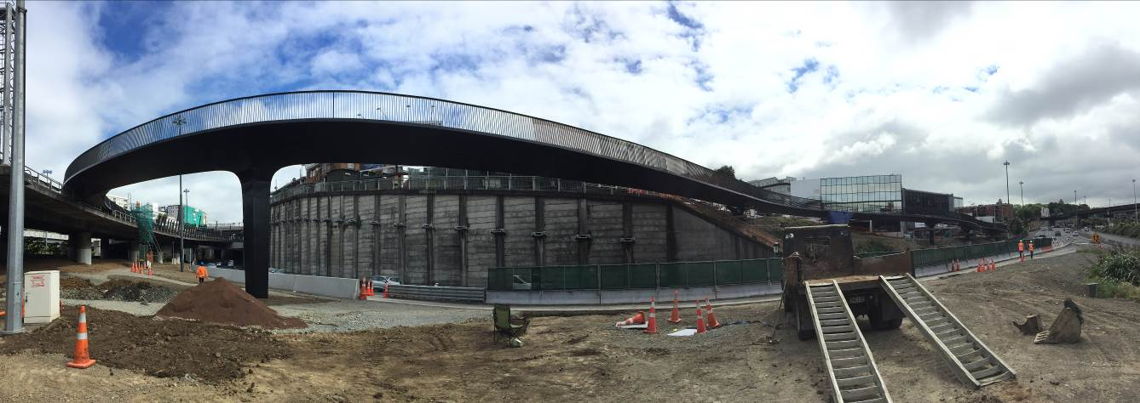
Why so long?
Reason why it’s a planning/tender challenge
Overland flowpath – programme implications
Source steel grade (330 tons)
Prequalifying Contractor and steel prefabricator (PFS)

Slide 22
Key Challenges
Options
Tender /
Planning
Construction
Story of the Option reassessment
Story of the Canada St Bridge
Story of the Offramp

Slide 23
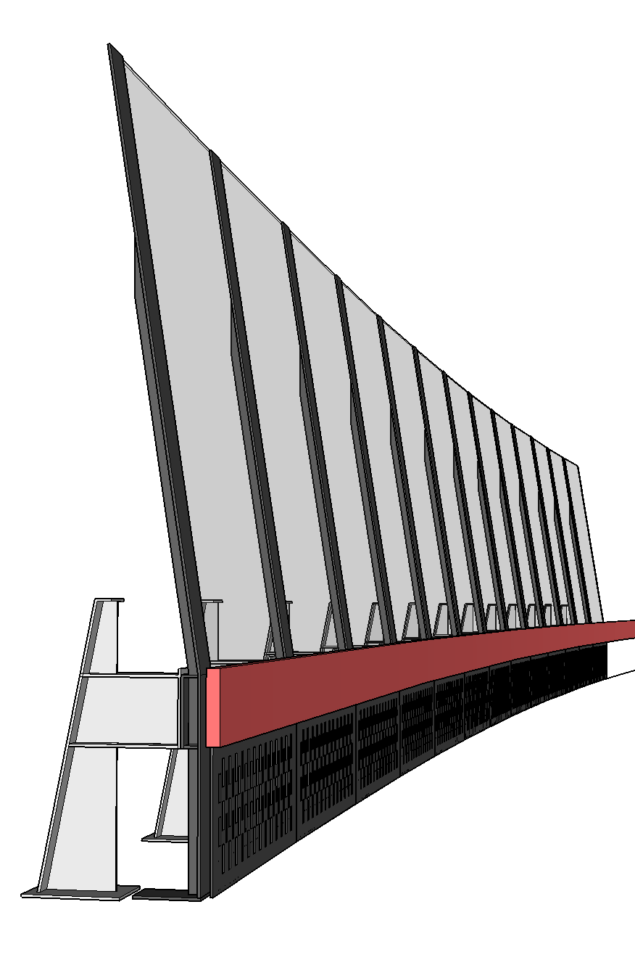
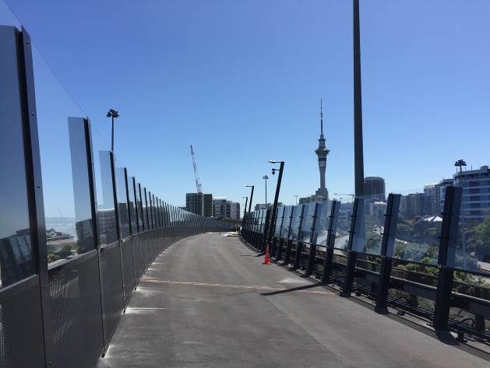
The Offramp Screens… Take 2
Original:
Guardrail to Front
New Design:
Guardrail behind the Screen
Image placeholder
Image placeholder
Image placeholder

Slide 24
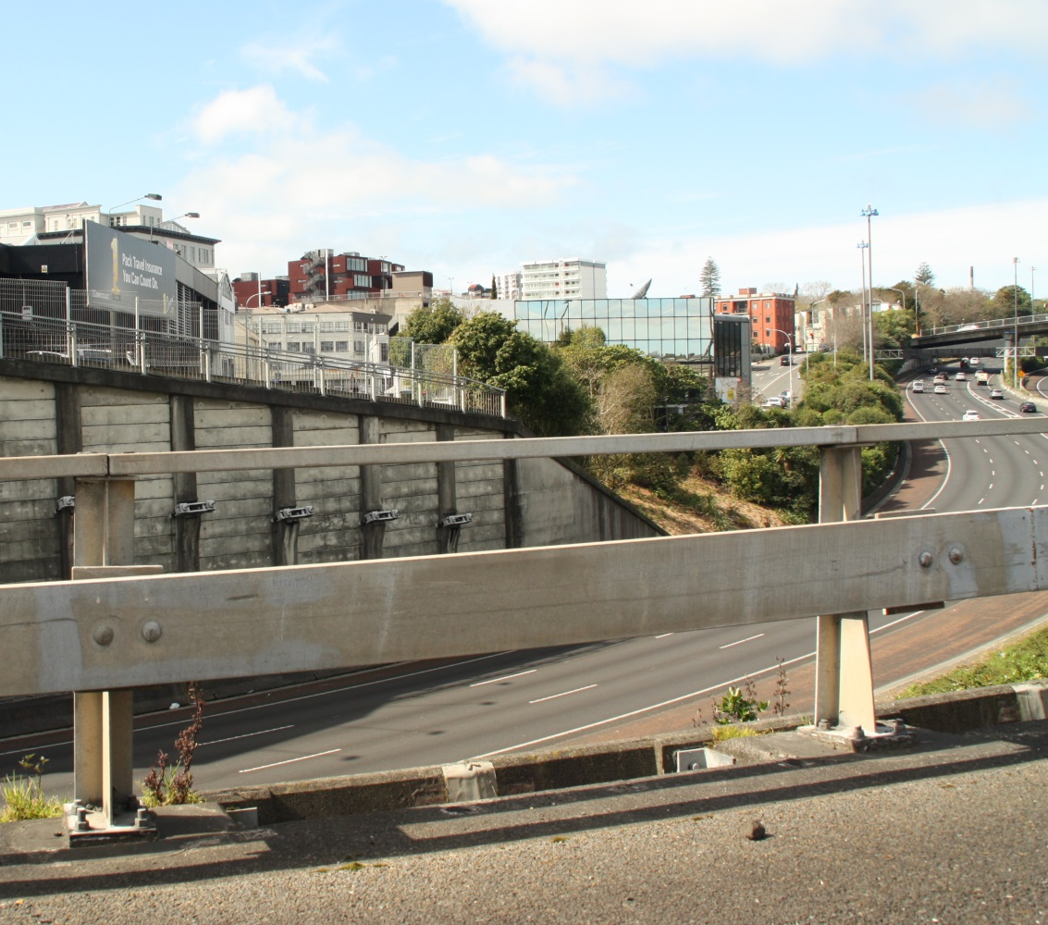
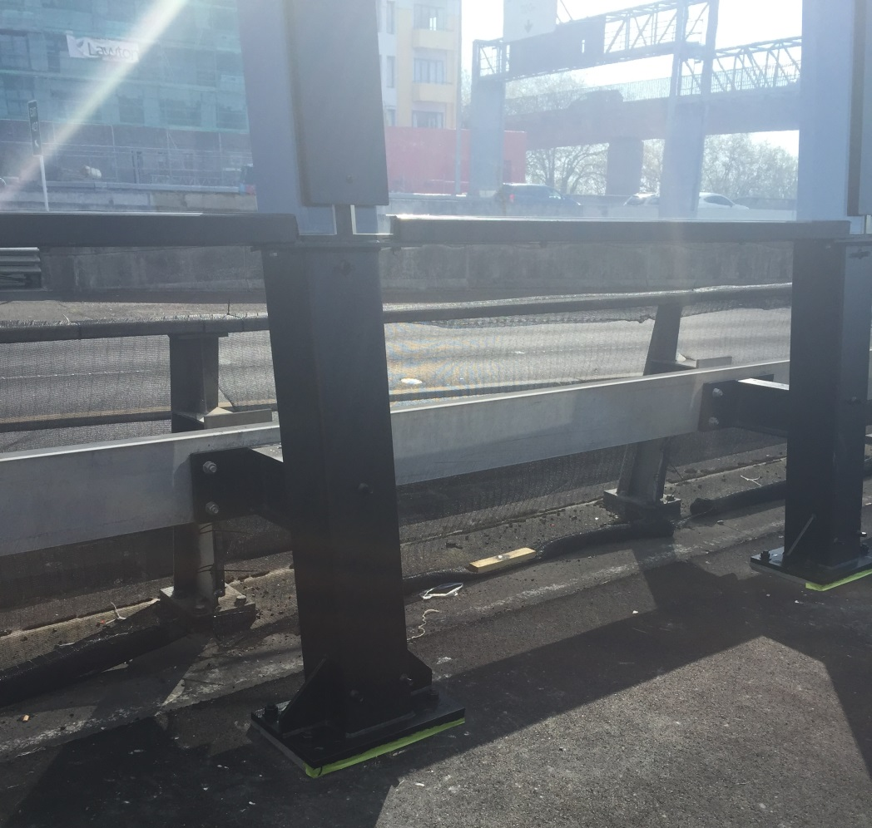
The quirks of old infrastructure
Over 600 unevenly spaced guardrail posts, with uneven connections:
18 standardised columns
14 standardised panel widths e.g. Plexiglas
Uprights
1.1 to 2.2m
Bolts width 100 – 230mm
Base Plate
Height varies 490 to 575mm
Width 230 or 240mm

Slide 25
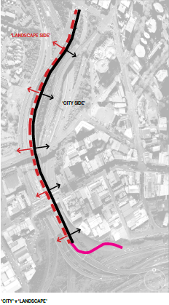
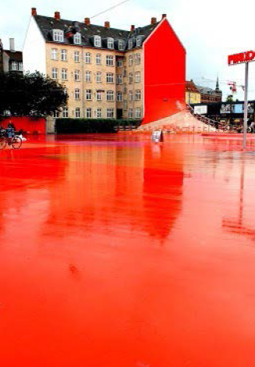
Can we do more? Get Inspired
Image placeholder
Image placeholder
Image placeholder

Slide 26
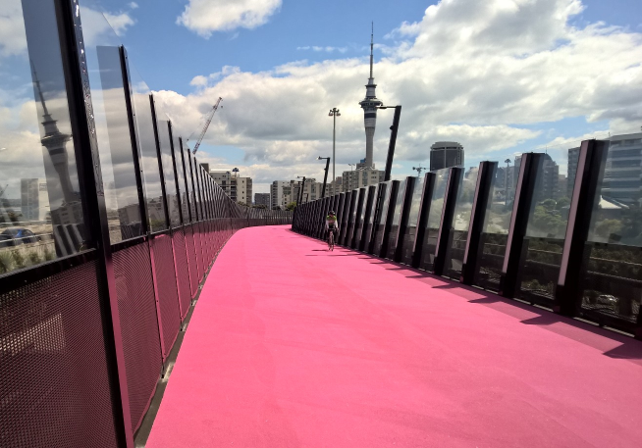
Harbour/View
Image placeholder
City/Lighting
Luminaire – Italy
Light Controller – USA
Sensor Camera – Corys
CCTV – AMA
Plexiglas – Germany
Graffiti Guard – Israel
Posts and
Perforated
Screens –
Culham’s,
Whangarei
Bespoke LED
Units & Trunking -
Corys Electrical
Resin
Surfacing

Slide 27
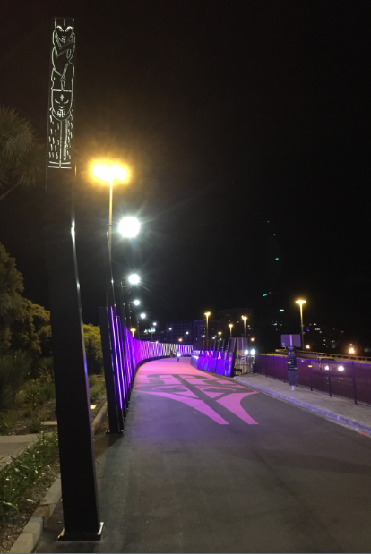
“I knew it was going to be memorable, but I didn’t know that it had soul, that it had mana, that it had spirit..” Barbara Cuthbert, Bike Akl
Koru
Marker Pou
Art Panels
Artist Katz Maihi of Toitu Design and Te Puia (the NZ Maori Arts and Crafts institute)

Slide 28
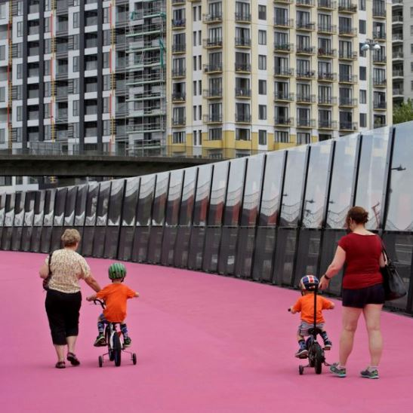
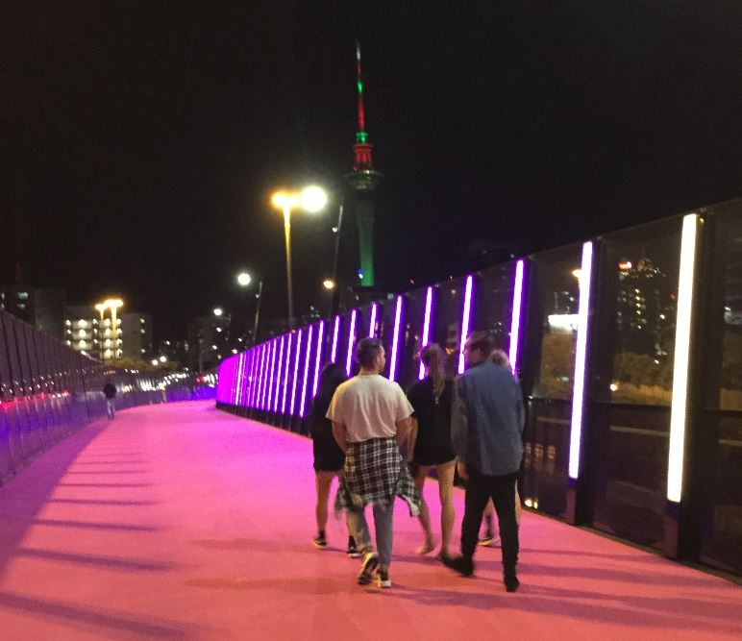
This is what is all about

Slide 29
What Were the
What is the purpose of my talk?
What were the challenges we faced, how we adapted, and how the project evolved
Options
Tender /
Planning
Construction

Slide 30
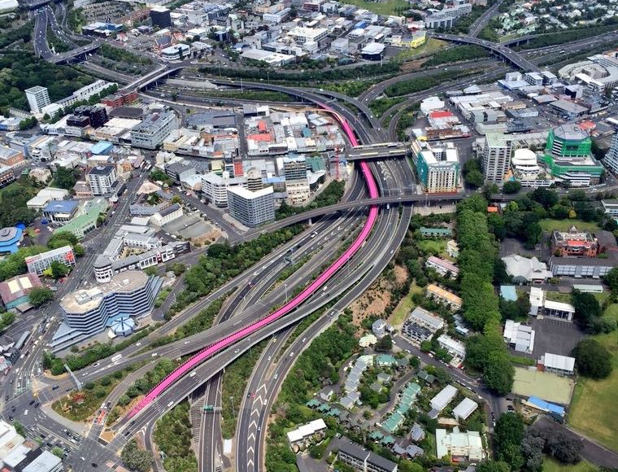
www.ghd.com

