Slide 1



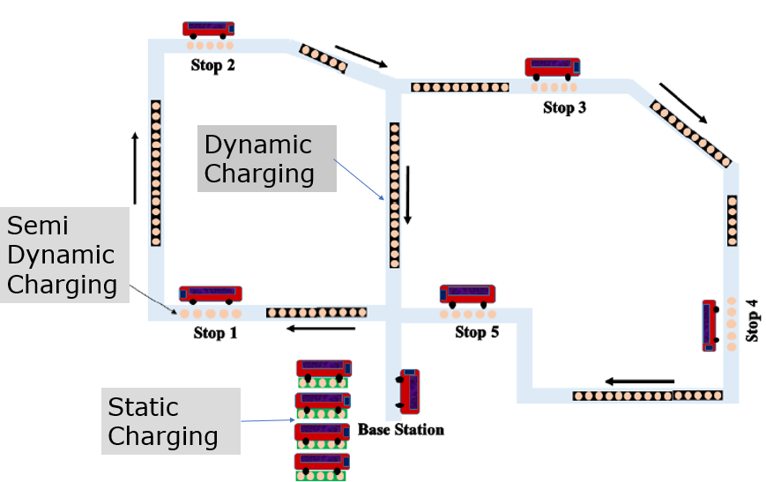
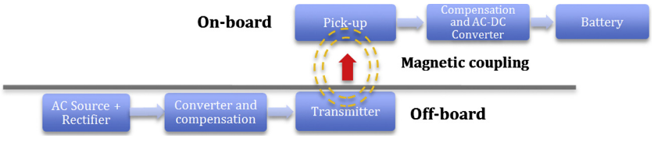
Towards the Electrification of Road Infrastructure
Parichehr Dogani Aghcheghloo, Douglas Wilson, Tam Larkin, University of Auckland, New Zealand
Types of Wireless Charging of EVs
Growth in population
Fossil fuels has harmful effects
Wireless Charging of EVs

Slide 2






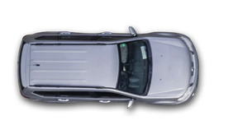
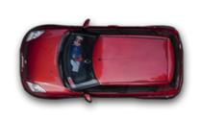
AVAILABLE PARKING
0.0 miles ahead.
Static EV Charging
MAINTAIN 25MPH
Green Light Timer: .08sec
Semi-Dynamic EV Charging
Stationary & Dynamic
Around town: little & often
WARNING SIGN
Construction zone in 2 mi.
!
Dynamic EV Charging
Notes:
Multiplicity of charging opportunities will encourage EV uptake
Charge little, often and everywhere
Simple to Deploy, no street clutter
Encourages intensive charging infrastructure
Reduce battery size and EV cost
Enables electric vehicles that are lightweight, inexpensive, have unlimited range while charging wirelessly
In the future enable charging circuitry to be buried below the surface of roads or highways, removing need to stop and recharge
Wireless Charging enables Self Driving Vehicles to charge Autonomously…one can foresee a time when car share, and robotaxis charge themsevles without human intervention.

Slide 3
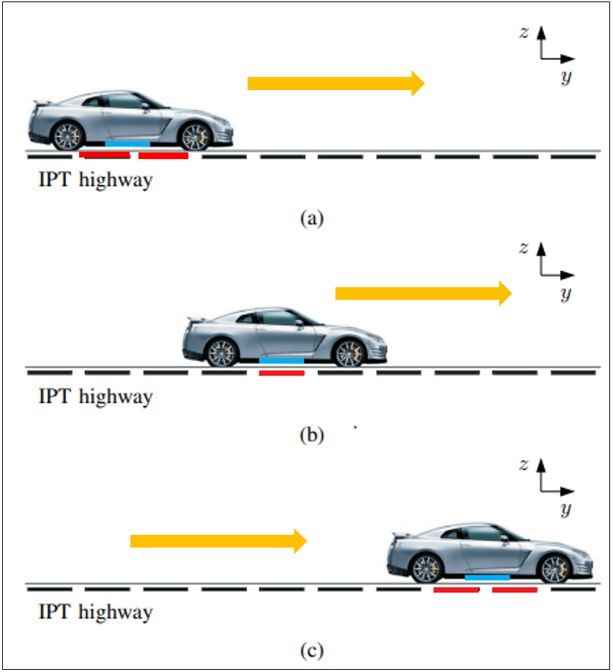
Dynamic Charging of EVs
Challenges and Future work
High cost
The electrical performance of the IPT system should not be negatively affected.
The performance of the pavement should not be negatively affected.
Thank you

