Slide 1
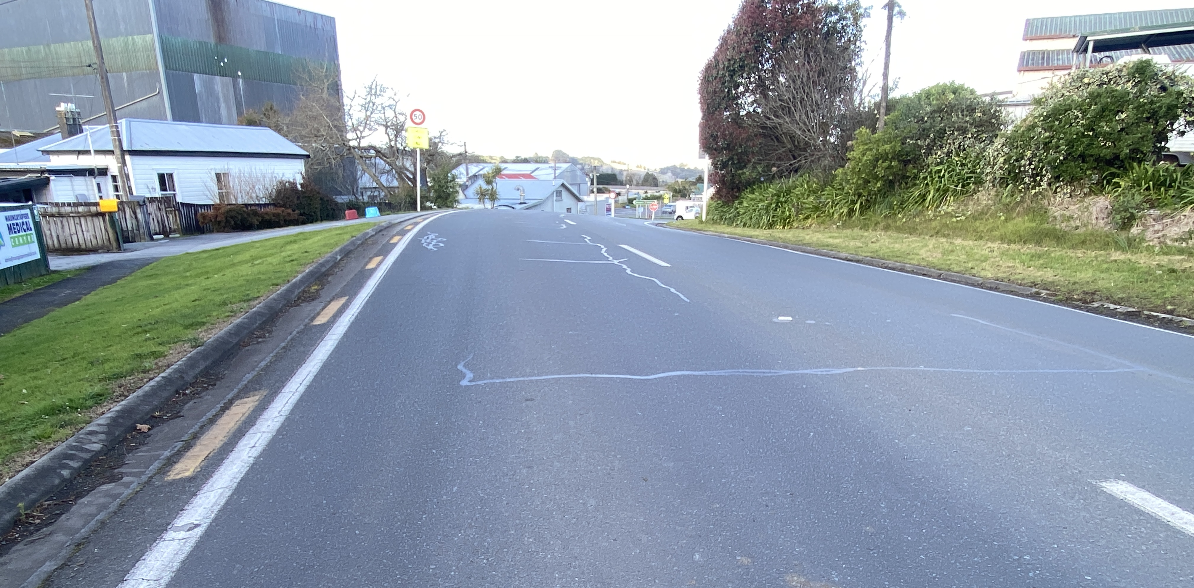
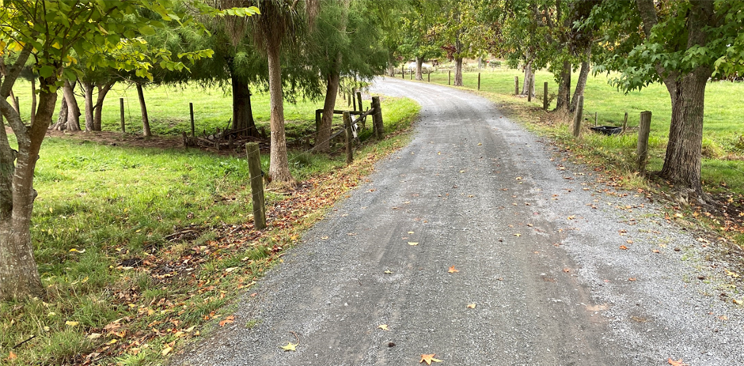
HOW IS ROAD WIDTH RELATED TO HARM?

Slide 2
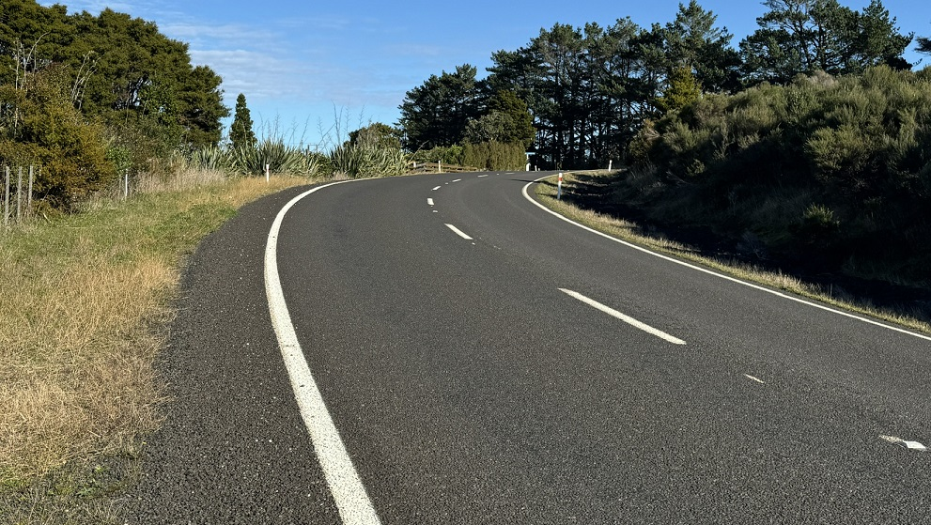

Slide 3
Why this research?

Slide 4
REINVENTING THE WHEEL?
Other research?
Notes:
Hasn’t this already been done?

Slide 5
Notes:
Using mapping software that allowed me to toggle between the maps and a spreadsheet.

Slide 6
ROAD METADATA

Slide 7
harm?
Road toll?
DSI?
Injury crashes?
“Social cost” of crashes (MBCM)? ✔ Standardised by VKT

Slide 8
What was counted?
Crashes of Types A, B, C, D, E, F, N, P and QE (CAS)
Notes:
Or what do I define as a midblock crash

Slide 9
What was counted?
Crashes of Types A, B, C, D, E, F, N, P and QE (CAS)
From normal road speed/under normal conditions.
Notes:
Or what do I define as a midblock crash

Slide 10
What was counted?
Crashes of Types A, B, C, D, E, F, N, P and QE (CAS) From normal road speed/under normal conditions.
Drivers distracted, fatigued, impaired by alcohol or drugs.
NOT:
Crashes shortly after a vehicle set off

Slide 11
What was counted?
Crashes of Types A, B, C, D, E, F, N, P and QE (CAS)
From normal road speed/under normal conditions.
Drivers distracted, fatigued, impaired by alcohol or drugs.
NOT:
Crashes shortly after a vehicle set off
Medical events,

Slide 12
What was counted?
Crashes of Types A, B, C, D, E, F, N, P and QE (CAS) from normal road speed.
Drivers distracted, fatigued, impaired by alcohol or drugs.
NOT:
Crashes shortly after a vehicle set off
Medical events,
Assault with a vehicle,

Slide 13
What was counted?
Crashes of Types A, B, C, D, E, F, N, P and QE (CAS) from normal road speed.
Drivers distracted, fatigued, impaired by alcohol or drugs.
NOT:
Crashes shortly after a vehicle set off
Medical events,
Assault with a vehicle,
Directly related to fleeing of Police and/or a pursuit.

Slide 14
What was counted?
Crashes of Types A, B, C, D, E, F, N, P and QE (CAS) from normal road speed.
Drivers distracted, fatigued, impaired by alcohol or drugs.
NOT:
Crashes shortly after a vehicle set off
Medical events,
Assault with a vehicle,
Directly related to fleeing of Police and/or a pursuit.
Crashes on one-way roads

Slide 23
Why this research?

Slide 24
