Slide 1
Annual General Meeting
Trips Database Bureau
Wednesday 25th September 2024

Slide 2
Housekeeping:
Please keep your mic on mute unless invited to ask or answer a question or if you have a point of clarification.
Best to keep videos off too to save bandwidth.
As we need a quorum of 10 members – can you please say in the chat if you are and which organisation (difficult to see in teams where you are from).
For voting we will accept either a hand raise, a yep, yes or whoop whoop in the chat or if you can unmute quick enough just shout your name (please also unraise your hand afterwards).
If anyone has Any Other Business they want discussing at the the end – either signal it or add it in the chat or email Caron at tripsdatabasebureau@gmail.com

Slide 3
2024 ANNUAL MEETING AGENDA
NOTICE of the Twentieth Annual Meeting of the Trips Database Bureau to be held online via Teams, 12:30 pm, Wednesday 25th September 2024 was sent to all members of TDB via email and posted on the website 11th September 2024.
Note: A quorum for the AGM is not less than 10 members.
Notes:
WELCOME
I declare the 18th Annual General Meeting of the Trips Database Bureau open. It is a pleasure to welcome you all. Thank you for showing your interest by dialing here tonight.
The Annual Reports and Annual Accounts have been posted on the TDB page of the Transportation Group website with the link circulated to you in advance for your approval – I am happy to go over any details as we get to them but we will be going through this quite quickly.

Slide 4
2024 ANNUAL MEETING AGENDA
The business of the Twentieth Annual General Meeting shall be:
Attendance, Contact/Nominees and Apologies
(Note only full member primary contact persons or their nominated representatives confirmed at the meeting may vote)
Consider and confirm the minutes of the Nineteenth Annual Meeting, held via Teams at 12:30pm Wednesday 22nd September 2022
Notes:
APOLOGIES
I now call for any apologies. I move that these apologies be accepted. Seconder?
Those in favour please say Aye. Against? Carried.
MINUTES
The minutes of the last Annual General Meeting have been circulated. Are there any amendments?
Would someone move that this is a true and correct record of what took place at the last AGM. Seconder?
Those who were present and are in favour please say Aye. Against? Carried.
The Chairperson now signs the minutes as correct.
MATTERS ARISING
Is there any business arising from the minutes?
Briefly discuss any topics raised.

Slide 5
2022 ANNUAL MEETING AGENDA
To receive the reports Financial Statement of the TDB for the period July 2023 to June 2024
The current accounts to June 2022 have also been sent to our auditor but are not available at this time. We will post them on the website when they become available.
A brief summary of the accounts are shown in the following slides along with a proposed budget. These are also contained in the papers.
Notes:
FINANCIAL REPORT
I now present the Financial Report and I thank Ravi for organising this for the TDB. I move that this report be received. Seconder?
The report is now open for discussion. The Treasurer comments on or reads the report, and answers questions.

Slide 6
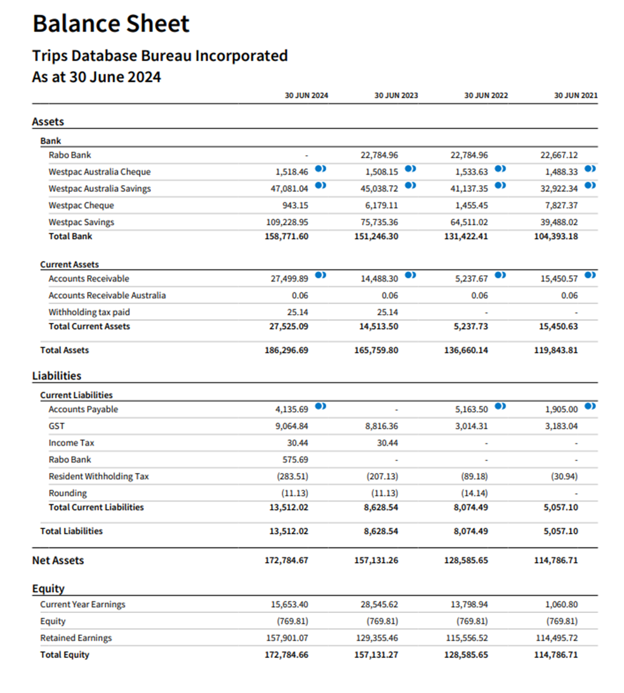

Slide 7
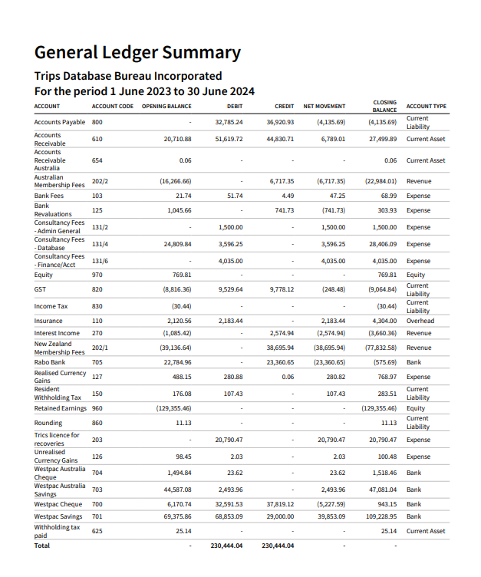
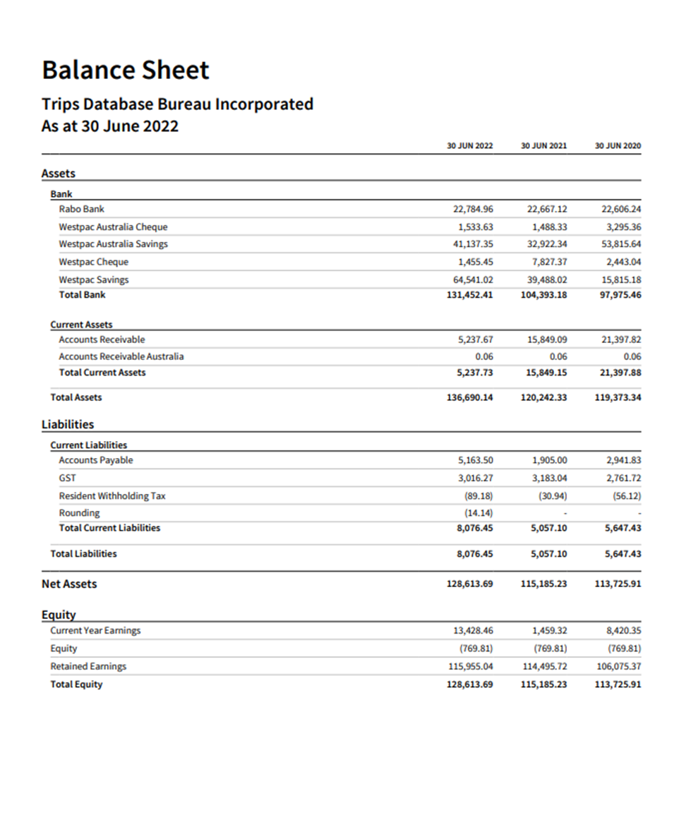

Slide 8
In summary:
 | 2023/24
Total Gross Income (excl GST) | $47,988.23
Total Expenses | $41,411.32
Surplus inc Tax | $6,576.91
Current Assets | $173,067.41
Less Current Liabilities | $9,064.84
Net Current Assets | $179,644.32
Overall the membership fees provided $45,413.29 compared with the $48,000 budgeted
As of June 2024:
NZ Members = 21
Australian Members = 7
Over the past year, we have gained a couple of small companies back after a couple left after Covid. We have lost one major consultancy in Australia (Aurecon) due to changes in personnel at the organisation and their finance team being extremely difficult to deal with.

Slide 9
2023/2024 Performance against the Annual Plan.
As there was no AGM in 2023 the budgets approved in 2022 were rolled over into 2023.
The performance against the Annual Plan presented to the 2022 Annual meeting is set out in the second and third columns of Appendix 2.
The objectives in the plan are:
Obj 1 – Grow Membership: Under by $1,000
Obj 2 – Revise Database: Underspent by $6,613.28
Obj 3 – Assist with Surveys/research: Underspent by about $15,000
Obj 4 – Administration: Overspent by about $8,600
Obj 5 – Research: Underspent by $0.00 (covered in Objective 3)
The total operational under expenditure was about $6,576.91.
This is due to:
Surveys not progressing this year as budgeted for.
Higher than budgeted for Auditing expenses and increase in insurance fees.
Lower than budgeted Australian membership fees but higher NZ membership fees.
No contribution by TRICS for surveys as budgeted for.

Slide 10
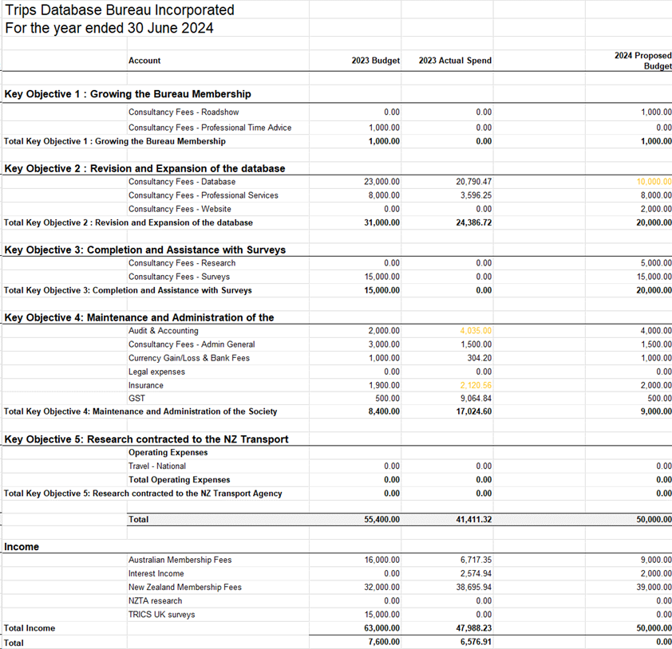
Proposed Budget 2024-25
Items to note:
Database fees are lower than previous years due to no TRICS license. This accounted for approximately $24k of expenditure. Future database management fees to be determined.
Auditing and insurance are budgeted to increase.
$5k set aside for research this year.

Slide 11
2022 ANNUAL MEETING AGENDA
Annual Report of the Executive Officer and the Chair for 2023/2024
Notes:
ANNUAL REPORT
I will now present the Annual Report.
Summary highlights from Annual Report are below.

Slide 12
Summary of Annual Report
Since the last Annual Meeting, held online 27th September 2022, the Board has held 5 formal Board meetings via teleconference and discussed key business via email.
Correspondence with members include an online survey with regard to TRICS usage in March 2024 and a follow up email to members in April 2024 with regard to TDB and TRICS.
The Board for 2023 - 2024 comprised:
NEW ZEALAND
Tony Brennand (Chairman Wellington)
Chris Freke (Auckland)
Ranjan Pant (Auckland)
Antoni Facey (Timaru)
Phillip Brown (Auckland)
Mark Gregory (Christchurch)
Stuart Woods (Christchurch)
AUSTRALIA
Supun Perera (Sydney)
Peter McIntyre (Sydney)
SUPPORT
Dave Smith (Technical and Research Support)

Slide 13
Over the past year, we have gained a couple of small companies back after a couple left after Covid. We have lost one major consultancy in Australia (Aurecon) due to changes in personnel at the organisation and their finance team being extremely difficult to deal with.
Reasons for others leaving is mainly due to costs or in some cases where membership was linked to one or two people in the company and they have left or retired, and the company has chosen to not renew.
TDB Membership
A1 National/State Government | 1
B1 Council over 100,000 population | 2
B2 Council 20,000 – 100,00 population | 1
C1 Consultancy – over 3 offices | 4
C2 Consultancy – 2-3 offices | 2
C3 Consultancy – single office | 9
C4 Consultancy – sole trader | 6
Professional group/interest group | 2
Total | 27

Slide 14
There have been no Newsletters sent out in the past year due to work pressures on the Board members and the Executive Officer.
We have also been busy with the disassociation with TRICS and the TRIPS research being undertaken in Australian.
Current website access is via the TDB sub-group page on the Engineering NZ website. We are working on a new website and have commissioned work on this – watch this space.
Due to resources the number of surveys undertaken has been low.
New surveys from NSW have been acquired and added to the database – these included surveys of golf clubs and marinas and a few others.
Before the disassociation with TRICS survey data collected still needed some manual processing.
TDB will continue to encourage members to contribute data and surveys, and introduce acceptable information into our database, in the ongoing basis on which TDB was initially founded.
It is understood that work in 2022 for NZTA is still to be incorporated into the PPM.
Research projects that have been undertaken since 2022 with the help of Ableys include:
1. The benefits of travel plans;
2. The correlation of parking rates to trip rates;
3. An update of the trip rates that are in RR453.
We are looking for ideas for other research and have been in contact recently with RMIT and the University of Canterbury.
Ideas include updating the full RR453 report – although that as partially done above.
Also a piece on car ownership versus car use with regard to parking rates.
Notes:
There being no (further) discussion would someone move that this report be received. Seconder.
Those in favour please say Aye. Against? Carried.

Slide 15
2024 ANNUAL MEETING AGENDA
5. Elections for the Board
Tony Brennand is up for re-election.
We still have 2 vacancies for Australian members.
Any more nominations?
Notes:
COMMITTEE MEMBERS
Those in favour please say Aye. Against? Carried.
XXX are duly elected.

Slide 16
2024 ANNUAL MEETING AGENDA
6. Any other business
Two items:
Incorporated Societies Act 2022 Trips Database Bureau Constitution 2024
In general the update to the constitution includes:
the ability to meeting and vote online
Updated section on disputes
Updated section on Board (officers) duties and disqualifications
b) Update on database
Notes:
GENERAL BUSINESS
The next item on the agenda is general business.
Is there any general business?
NEXT MEETING
The date of the next meeting will be in September 2022 to be confirmed.
CLOSE MEETING
There being no (further) general business, I declare this Annual General Meeting closed. (time)

Slide 17
Thank you and we now welcome Dave Smith from Ableys to lead the presentation and discussion some research on High Trip Generators.

